Slide 2
Implementation

Slide 3
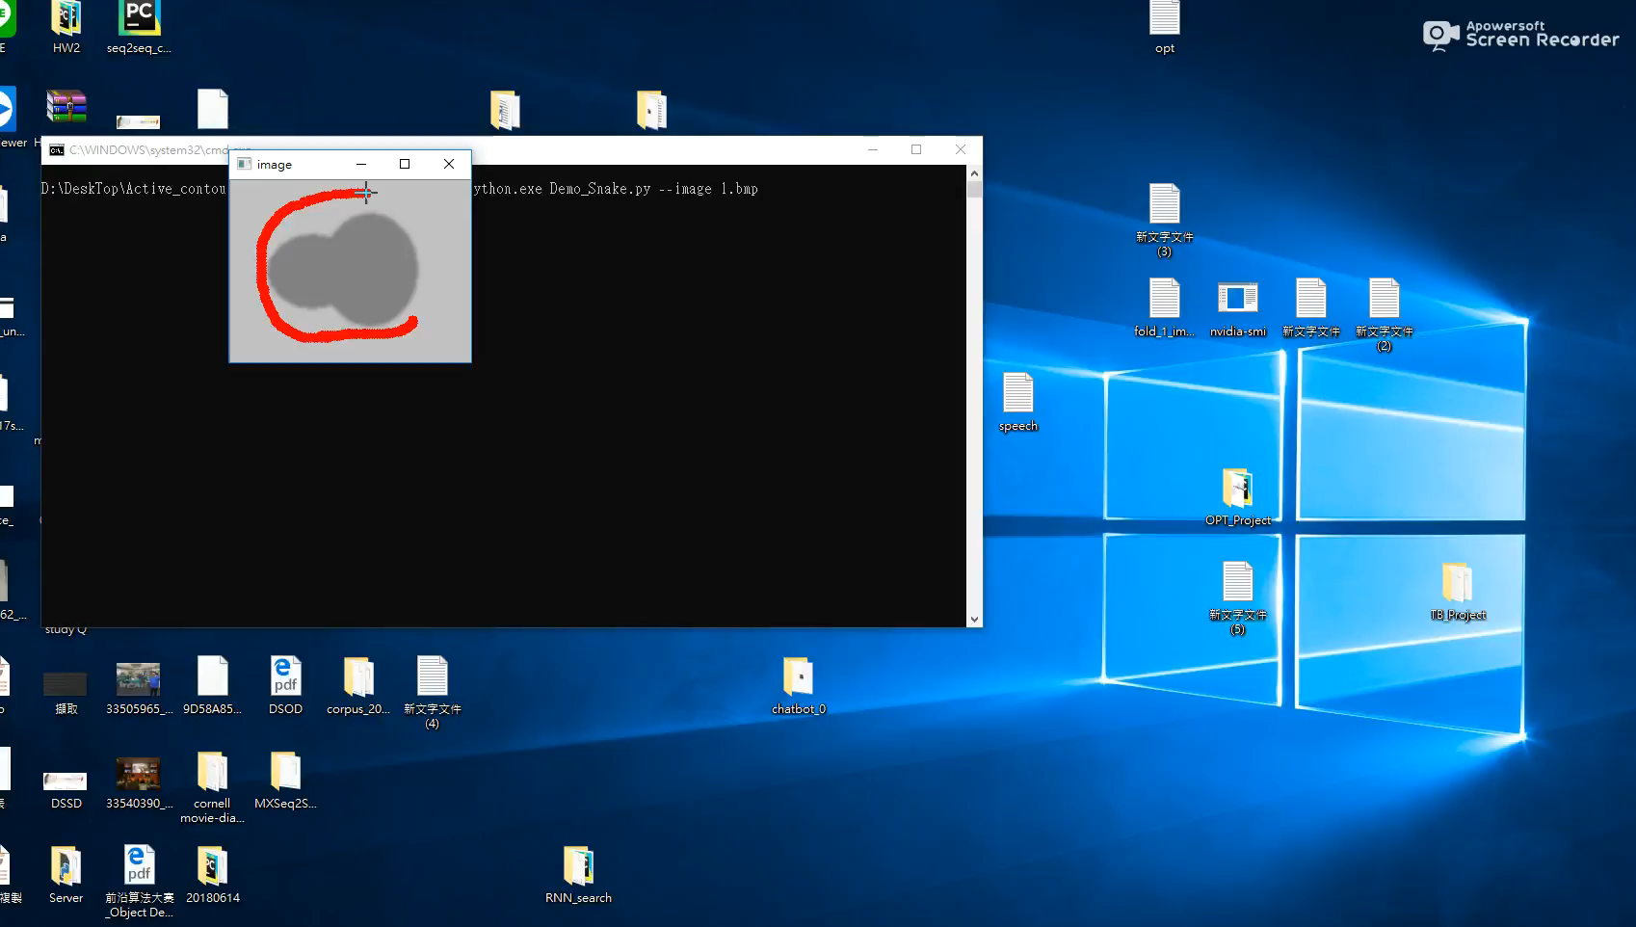
Notes:
Let’s take a look at Active contour method
First draw a contour for initial, and self adapting in their search for minial energy

Slide 4
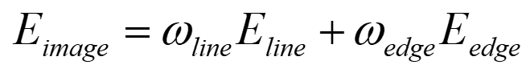

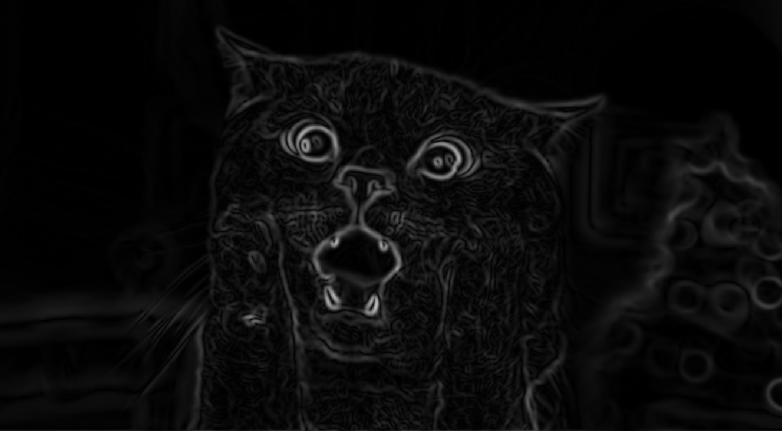
Our Image energy
Gaussian image
Sobel image
Notes:
The image energy is derived from the image data.
where ω is an appropriate weighting function.

Slide 5

Gaussian smoothing
Gaussian image
Gaussian smoothing is used to blur images and remove noise , detail and as a pre-processing stage in image processing algorithms in order to enhance image structures

Slide 6
Sobel filter
Sobel filter, is used in image processing and particularly within edge detection algorithms where it creates an image emphasising edges
Gaussian image
Sobel image

Slide 7
Optimization technique
Based on a spline
Minimization the energies of the spline
Deforms to fit local minima
Local, not global, so initial location must be provided

Slide 8
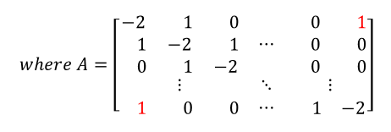
A matrix
N = contour length (Number of Contour Points)
few points to consider => result bad
More points => Affect the speed of convergence
Create A matrix with shape[NxN]
[NxN]

Slide 9
update
InvA = Inverse of A Matrix
New_x = InvA * Old_x
New_y = InvA * Old_y
dx = max_move * tanh (new_x – old_x)
dy = max_move * tanh (new_y – old_y)
old_x += dx
old_y += dy
Dist = min((new – old), 1)
stop when Dist < 0.1 or iteration 2000

Slide 10
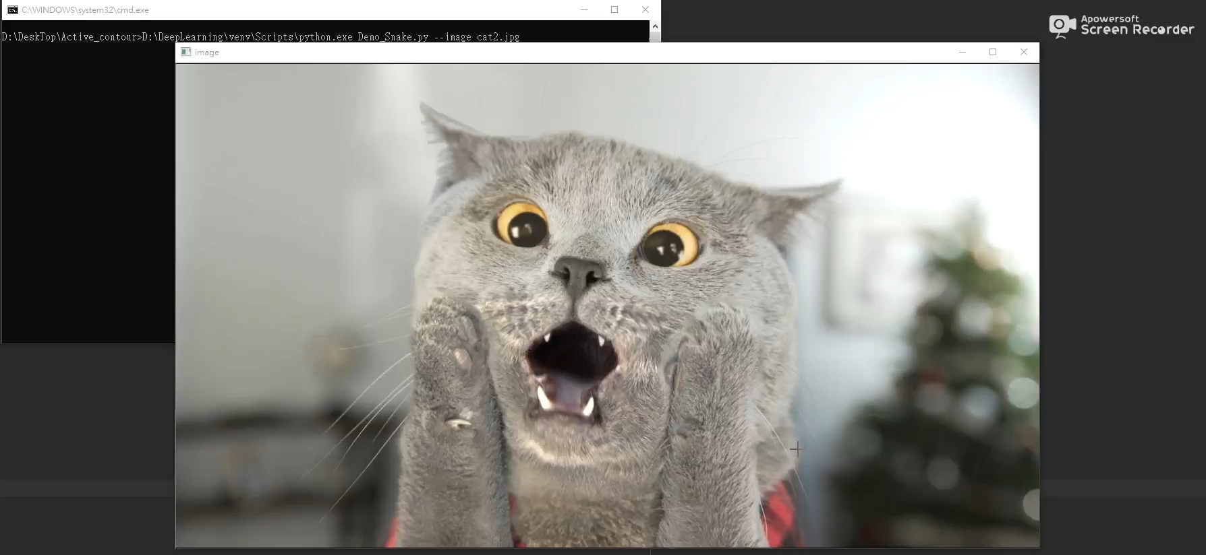

Slide 11
conclusion
Pros:
Prove that snakes is useful for interactive specitication of image contours.
Cons:
lack of some background

